Slide 1
Hand Gesture To Voice Translator For Mute People Using Msp430
Presented by : Guided By:
T.Divya (211411106044) Mrs. S. Sujitha,
K.S.Indhushree (211411106054) M.E.,
A.Jenifer (211411106060) (Asst. professor)
S.Kiruba (211411106314)

Slide 2
Objective:
This project aims to lower the barrier in human communication.
It is based on the need of developing an electronic device that can translate a sign language into speech in order to make the communication effective between the mute communities with the general public .

Slide 3
Literature survey table:
Title Of The Paper | Author & Year Of Publication | Objective | Limitations
Asl fingerspelling translator glove Wireless communication glove apparatus for motion tracking, gesture recognition, data transmission, and reception in extreme environments | Jamal S. Haydar, Bayan Dalal, Shahed Hussainy, Lina El Khansa, Walid Y. Fahs 2011. M. G. Ceruti 2012 | To convert sign language to text format which is transmitted through Bluetooth and displayed in PC. In extreme environments by certain hand gestures are used to communicate or seek help from others. | Bluetooth provides very short range communication and also affording Bluetooth supporting device is not always possible. In this way only a help signal is generated using hand gesture which does not help mute people completely.

Slide 4
Literature survey table:
Title Of The Paper | Author & Year Of Publication | Objective | Limitations
A proposed voice encryption system based on off-line ICA algorithm Deaf-mute communication interpreter | Dr. Eng. Sattar B. Sadkhan, Dr. Nidaa A. Abbas 2013 Anuja Golliwar, Harshada Patil , Rohita Watpade , Sneha Moon , Sonal Patil,V. D. 2014 | sign language is converted into encrypted voice. Sign language is converted into text that displayed in LCD to help deaf-mute communication | This method produces computer generated voice which is disliked by the user. Illiterate people and visually challenged find it difficult to communicate with mute community.

Slide 5
Existing system :
It is capable of converting the hand gesture into codes that are understandable by computer.
However these codes are routed to particular letter and then they are displayed in LCD monitor for human to understand.
Single word is displayed in LCD letter by letter which is a time consuming process.

Slide 6
Proposed system
Since the output of the existing system is in text form illiterate people find it difficult to understand.
Hence in the proposed system the digital value generated by ADC is mapped to recorded voice.
Therefore when a mute people show their gesture the pre recoded voice is played.
Using this system the communication between the mute people and others is made easy.

Slide 7
Block diagram:
FLEX SENSORS
(3)
M
S
P
4
3
0
M
S
P
4
3
0
A
P
R
9
6
0
0
MIC
PLAY/REC
ZIGBEE TRANSM-ITTER
ZIGBEE RECEIVE-R
SPEAKER
MEMS BASED ACCELER-OMETER
TRANSMITTER UNIT
RECEIVER UNIT

Slide 8
Detection Unit: Flex sensors:
The flex sensor patented technology is based on resistive carbon elements.
Flex sensors are normally attached to the glove using needle and thread.
They require a 5volt input and output between 0 and 5 volt, the resistivity varying with the sensor’s degree of bend and the voltage output changing accordingly.
It will only change resistance in 1 direction. An unflexed sensor has a resistance of about 10,000 ohms. As the flex sensor is bent, the resistance increases to 30-40 kilo ohms at 90 degrees.

Slide 9
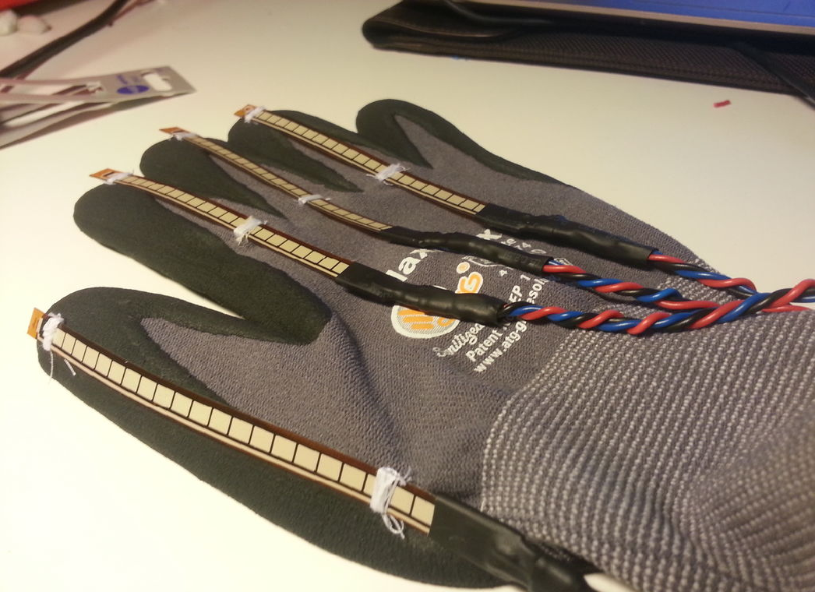
Flex sensors

Slide 10
MEMS Based Accelerometer
The MMA7361L is a low power, low profile capacitive micro machined accelerometer featuring signal conditioning, a 1-pole low pass filter, temperature compensation, self test.
It provides low voltage operation ranging from 2.2v to 3.6v.
It has a robust design and high shock survivability.
It a low cost device.

Slide 11
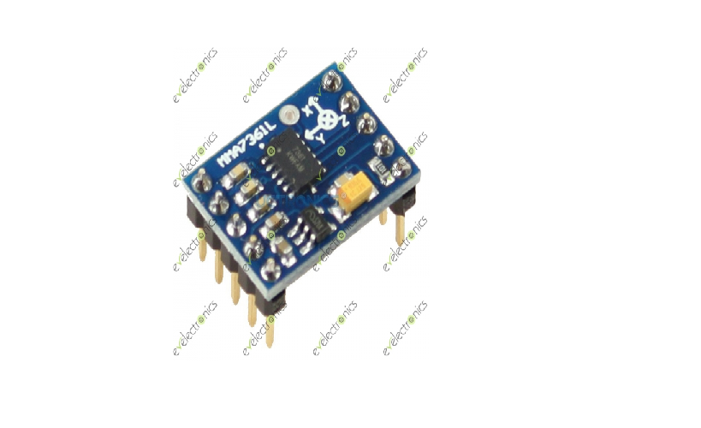
MEMS Based Accelerometer

Slide 12
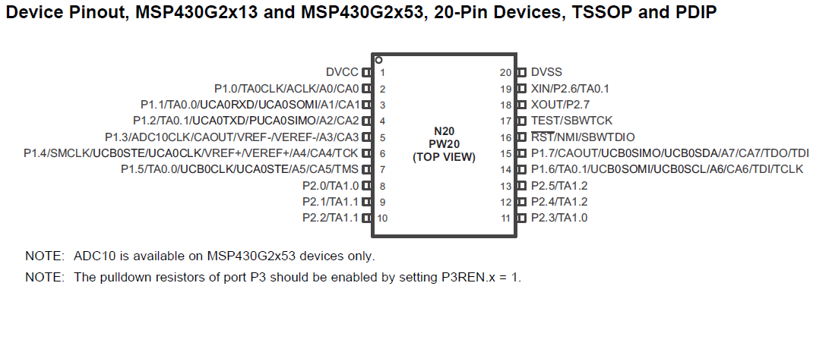
MSP430G2553

Slide 13
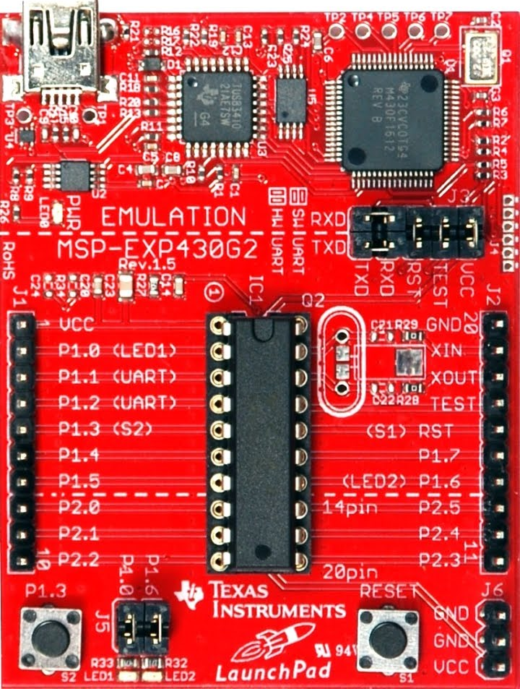
MSP430G2553

Slide 14
MSP stands for Multi Signal Processor which is similar to Aurdino, but it is designed by Texas Instrument.
It has a Von Neuman / Bottleneck architecture.
It has separate data and program memory.
Flash memory is used for both code and data.
It is a 40 pin DIP IC which has 2 ports p1 and p2.
Every pin has multi functions.
Each port has 8 pins. P1 supports analog input and p2 suppots digital values
Low Supply-Voltage Range: 1.8 V to 3.6 V.
Universal Serial Communication Interface

Slide 15
Ultra-Low Power Consumption (USCI)
- Active Mode: 230 μA at 1 MHz, 2.2 V Enhanced UART Supporting Auto Baud rate
-Standby Mode: 0.5 μA Detection (LIN)
-Off Mode (RAM Retention): 0.1 μA – IrDA Encoder and Decoder
Five Power-Saving Modes – Synchronous SPI
16-Bit RISC Architecture, 62.5-ns Instruction Compare Function or Slope Analog-to-Digital ➢ Cycle Time (A/D) Conversion
10-Bit 200-ksps Analog-to-Digital (A/D) ➢ Converter With Internal Reference, Sample- o Internal Frequencies up to 16 MHz With and-Hold, and Autoscan

Slide 16
Zigbee
Zigbee is used for wireless communication. It acts as a transceiver between the detection and voice unit.
Technological Standard Created for Control and Sensor Networks
Based on the IEEE 802.15.4 Standard
Created by the ZigBee Alliance
Features of zigbee
Power profile - Years
Complexity - Simple
Nodes/master - 6400
Latency - Enumeration 30ms
Range - 70 to 300m
Extendability - Yes
Data rate - 250 kbps

Slide 17
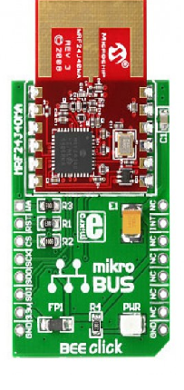
This zigbee module is used on both detection and voice unit

Slide 18
Voice unit
Voice unit has a zigbee receiver with MSP that controls voice IC APR9600.
APR9600 is connected with a microphone and a speaker.
Features of APR9600.
-Single chip, high quality voice recording &play back solutions.
-No external ICs required.
-Minimum external components
-Non-volatile flash memory technology
-No battery backup required.
-User selectable messaging options.

Slide 19
-Random access of multiple fixed duration messages
-Sequential access of multiple variable duration
messages.
User-friendly, easy to use operation
-Programming and developing systems not required.
Low power consumption
-Operating current: 25mA typical.
-Standby current: 1uA typical.
-Automatic power down.
Chip enable pin for simple message expansion

Slide 20
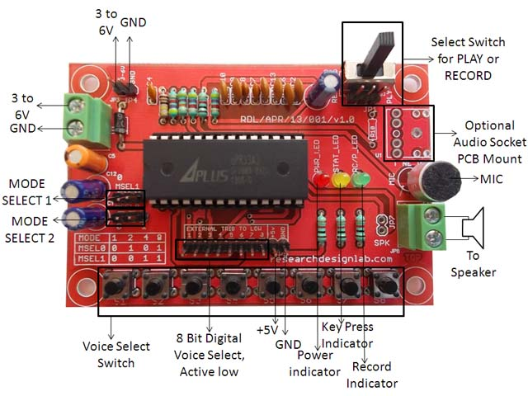
APR9600

Slide 21
Hardware Explanation
Outputs from three flex sensors and from an accelerometer are given as input to the analog pins of msp430 launch pad.
Each flex sensor has two output in which one is connected to ground and another to P1.0, P1.1 and P1.2 of msp430.
MEMS based accelerometer is used for sensing the hand gesture along three axis (x , y , z).

Slide 22
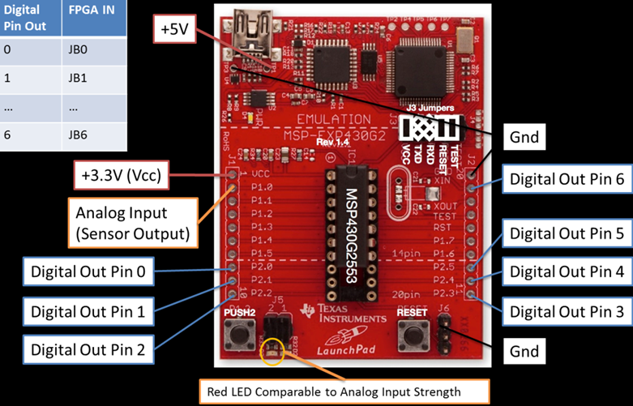
Here, z axis is considered as ground and the outputs along x and y axis are given as input to P1.3 and P1.4.
Msp430 has a 10 bit adc using which those five analog signals are converted into digital values.
These digital values are taken out from digital output pins ( P2.0, P2.1, P2.2, P2.3, P2.4, P2.5 ) of msp430.

Slide 23
These digital codes are transmitted to voice unit through zigbee module.
The voice unit consist of APR9600 voice IC which is controlled by MSP430.
APR9600 is connected to speaker and a microphone.
This module works in two mode record and play back mode which is set by rec/play switch.
Initially, record mode is set, hand gestures are made and the voices for those gestures are recorded.
Once the voices are recorded the playback mode is set.
In this mode when the had gesture is made it is recognized and the corresponding voice is played.

Slide 24

Energia:
Energia is an open source electronics prototyping platform.
It was designed to bring the wiring and Arduino framework to the Texas instruments msp430 based launch pad.
The Energia IDE is a cross platform and supported on Mac OS, Windows and Linux.

Slide 25
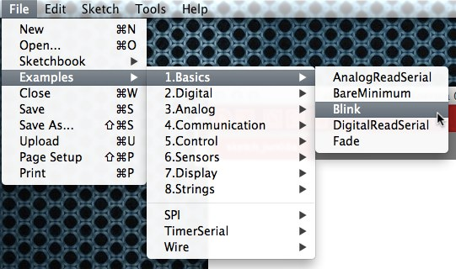
It has a complete list of all add-on programs in library.
Though Energia has so many advantages, simulation is impossible.
Hence, the output can be verified only in the hardware.

Slide 26
Coding
const int analogInPin1 = A6
const int analogInPin2 = A3;
const int analogInPin3 = A4;
const int analogInPin4 = A5
unsigned long int fx1,fx2,fx3,mems;
int sensorValue1 = 0; // value read from the pot
int sensorValue2 = 0; // value read from the pot
int sensorValue3 = 0; // value read from the pot
int sensorValue4 = 0; // value read from the pot

Slide 27
void setup()
{
// initialize serial communications at 9600 bps:
Serial.begin(9600);
}
void loop()
{
// read the analog in value:
sensorValue1 = analogRead(analogInPin1);
sensorValue2 = analogRead(analogInPin2);
sensorValue3 = analogRead(analogInPin3);
sensorValue4 = analogRead(analogInPin4);

Slide 28
mems=sensorValue1;
fx1=sensorValue2;
fx2=sensorValue3;
fx3=sensorValue4;
if(fx1<500)
{
Serial.println("1"); //Serial.println(fx1);
delay(5000);
}
else if(fx2<550)
{
Serial.println("2"); //Serial.println(fx2);
delay(5000);
}

Slide 29
else if(mems<390)
{
Serial.println("4"); //Serial.println(mems);
delay(5000);
}
else if(mems>=430)
{
Serial.println("5"); //Serial.println(mems);
delay(5000);
}
else if(fx3<=560)
{
Serial.println("3"); //Serial.println(fx3);
delay(5000);
}

Slide 30
#define play 8
#define v1 9
#define v2 10
#define v3 11
#define v4 12
#define v5 13
char inByte = 0; // incoming serial byte
void setup()
{
Serial.begin(9600);
pinMode(play, OUTPUT);
pinMode(v1, OUTPUT);
pinMode(v2, OUTPUT);
pinMode(v3, OUTPUT);

Slide 31
pinMode(v4, OUTPUT);
pinMode(v5, OUTPUT);
}
}
void loop()
{
// if we get a valid byte, read analog ins:
if (Serial.available()>0)
{
// get incoming byte:
inByte = Serial.read();

Slide 32
if (inByte == '1')
{
digitalWrite(v1,0);
delay(1000);
digitalWrite(play, 0);
delay(2000);
digitalWrite(play, 1);
digitalWrite(v1, 1);
Serial.println("play 1 on");
}
else if(inByte == '2')
{
digitalWrite(v2,0);
delay(1000);

Slide 33
digitalWrite(play, 0);
delay(2000);
digitalWrite(play, 1);
digitalWrite(v2, 1);
Serial.println("play 2 on");
}
else if(inByte == '3')
{
digitalWrite(v3,0);
delay(1000);
digitalWrite(play, 0);
delay(2000);

Slide 34
digitalWrite(play, 1);
digitalWrite(v3, 1);
Serial.println("play 3 on");
}
else if(inByte == '4')
{
digitalWrite(v4,0);
delay(1000);
digitalWrite(play, 0);
delay(2000);
digitalWrite(play, 1);
digitalWrite(v4, 1);
Serial.println("play 4 on");
}

Slide 35
else if(inByte == '5')
{
digitalWrite(v4,0);
delay(1000);
digitalWrite(play, 0);
delay(2000);
digitalWrite(play, 1);
digitalWrite(v5, 1);
Serial.println("play 5 on");
}

Slide 36
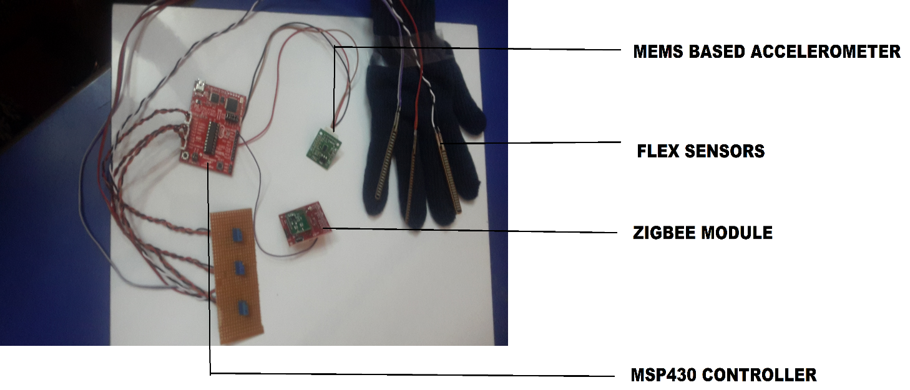
HARDWARE SNAPS DETECTION UNIT

Slide 37
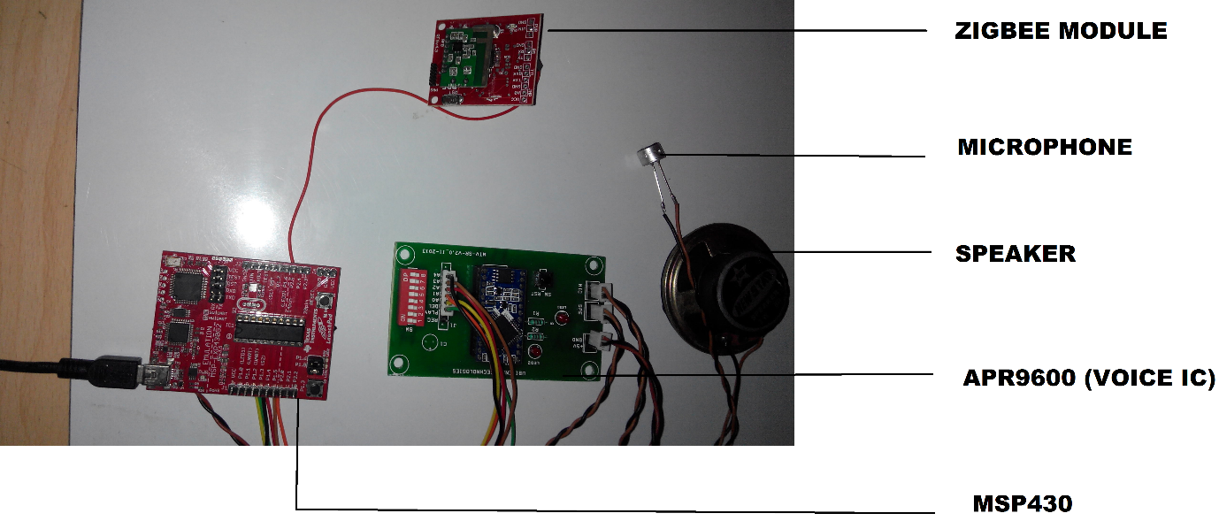
VOICE UNIT

Slide 38
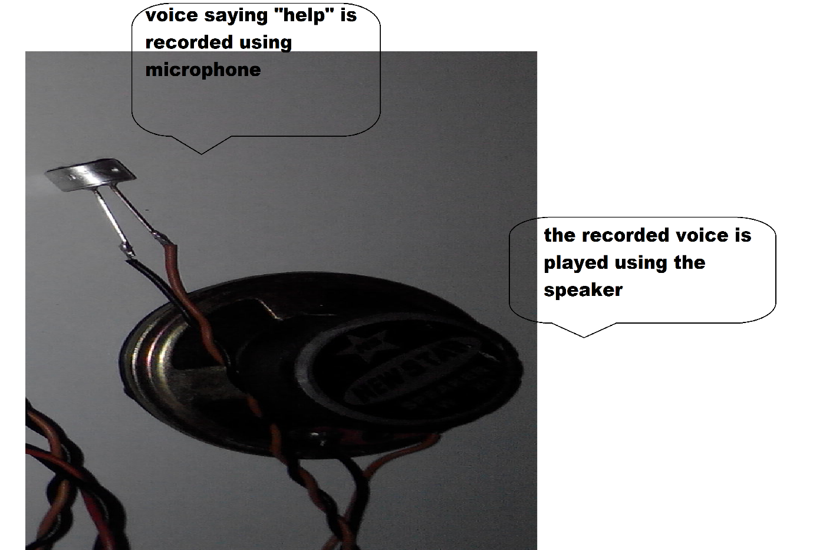
OUTPUT

Slide 39
Reference papers
S. Mitra and T. Acharya, “gesture recognition: A survey,” IEEE Trans. Syst., Man, Cybern., Part C Appl. Rev., vol 37, no 3, pp. 311-324, May 2007.
J.S.Wang and F.C.Chuang, “an accelerometer based digital pen with a trajectory recognition algorithm for handwritten digit and gesture recognition,” IEEE Trans.ind.electron.,vol.59,no. 7,pp. 2998-3007,jul. 2012.
M.G. Ceruti, V.V. Dinh, N.X. Tran,h.Van Phan, L.T. Duffy, T.A.Ton,et al., ”Wireless communication glove apparatus for motion tracking , gesture recognition, data transmission and reception in extreme environments," in Proc. ACM Symp.Appl.Comput.,2009, pp, 172-176.

